Slide 1




CRYPTANALYSIS
Energy-Based and Neuro-Symbolic Methods for Advanced Cryptanalysis
Mentors:
  GHRUANK KOTHARE
  AFREEN KAZI
Mentees:
  RISHIT MODI
  ANUSHKA YADAV
1.
1.
2.
2.
page 01

Slide 2

  This project aims to explore the use of AI, neural networks, and neuro-symbolic learning to analyze and break encryption schemes.
  We focus on attacking modern encryption systems like AES using intelligent and adaptive methods.
  We are inspired by energy-based models, Hopfield networks, symbolic logic, and quantum-inspired techniques.
  The goal is to simulate advanced attacks and understand how encryption logic can be learned by machines.
PROJECT OVERVIEW
page 02

Slide 3

studio shodwe
PROJECT GOALS
1.
2.
3.
Cipher Cracking
Learn to decrypt ciphertext without having the encryption key.
Key Recovery
Study how well modern encryption resists AI-based attacks.
Symbolic Cipher Learning
Train models to reverse engineer encryption logic based only on inputs and outputs.
page 03

Slide 4
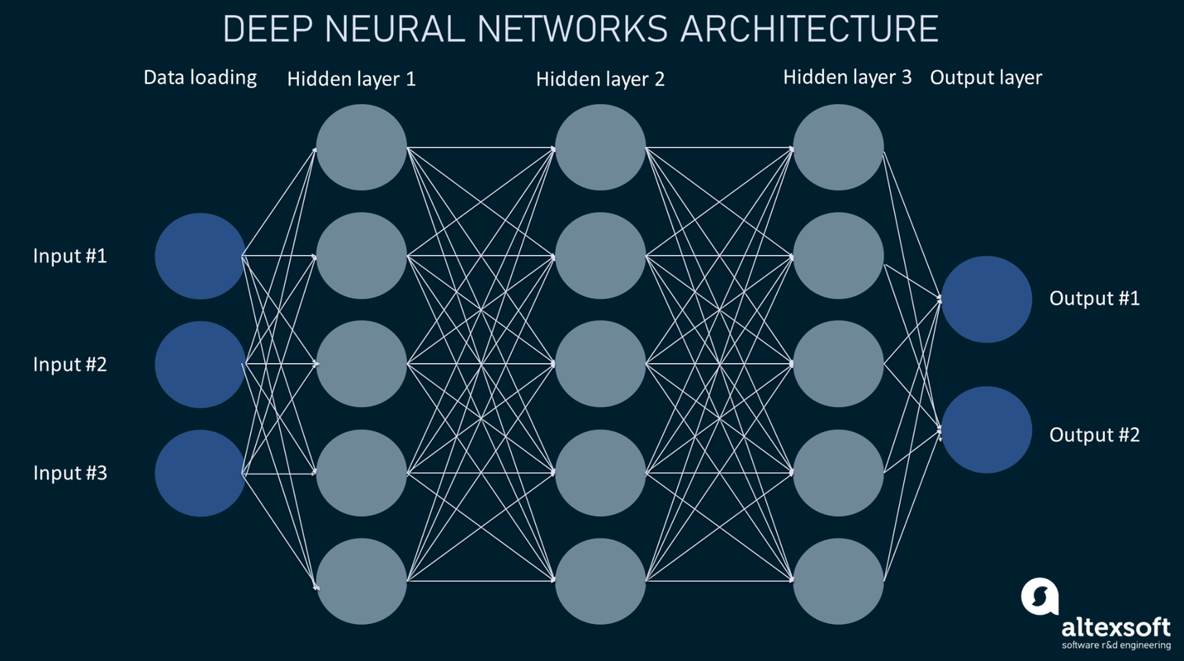
Learnings
Neural Network:
  Weighted sum Z = W·X + b
  Activation Functions: ŷ = g(Z)
Sigmoid: Good for binary outputs (0/1)
ReLU: Speeds up learning, avoids vanishing gradients
  Forward Propagation:
Input ➝ Hidden layers ➝ Output
  Backpropagation: Error flows backward, adjusts weights to minimize loss
  Loss Function: Binary/Categorical Cross Entropy used to measure prediction error
L(ŷ, y) = - y log(ŷ) - (1 - y) log(1 - ŷ)
  Gradient Descent: Update weights to reduce loss ==> w = w - α*dw
page 04

Slide 5
Improving Deep Neural Networks
Weight Initialization
Prevents vanishing/exploding gradients
Optimization Techniques
  Gradient Descent,
  Adam Optimizer
Hyperparameter Tuning
Layer size, learning rate, iterations
Regularization
(L2, Dropout)
Reduces overfitting
Gradient Checking
Debug tool to validate backpropagation
page 05

Slide 6


From Theory to Application
  DNNs to map ciphertext → plaintext
  ReLU/Sigmoid to model encryption logic
  Vectorization for faster data handling
  Dropout & L2 to reduce overfitting
  Adam for quick optimization
  Gradient check for accuracy
  Mini-batch training for scalability
page 06

Slide 7
Mini Project
Caesar Cipher Decrypter using Neural Networks
Objective:
  Encrypt plaintext using Caesar Cipher
  Decrypt ciphertext using a trained neural network
  No prior knowledge of shift required during decryption
Model Design:
  2/4-layer Feedforward Neural Network
  Activation: ReLU (hidden), Sigmoid (output)
  Encoded input/output using one-hot vectors
page 07

Slide 8
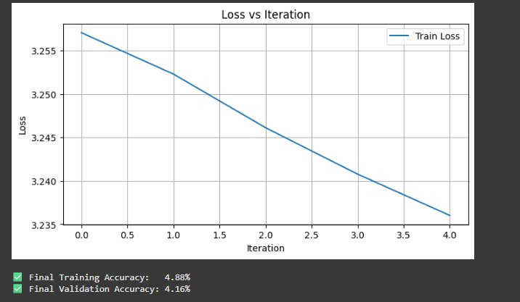

2 layer Neural Network
Performance:
Train Accuracy: 4.88%
Test Accuracy: 4.16%
page 08

Slide 9
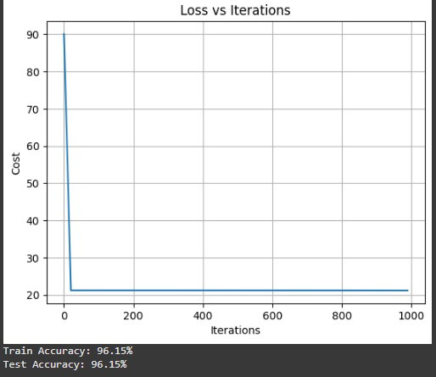
4 layer Neural Network with fixed key
Performance:
Train Accuracy: 96.15%
Test Accuracy: 96.15%
page 09

Slide 10
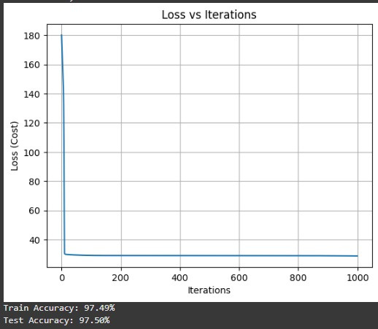
4 layer Neural Network with variable key and word length
Performance:
Train Accuracy: 97.49%
Test Accuracy: 97.50%
page 10

Slide 11
Future Work
Phase 3:
  Symbolic Logic Integration
  Fuse Transformer with symbolic rules (grammar, key patterns)
  Improves generalization and interpretability
Phase 1:
  Use basic neural networks to learn cipher patterns
  Train on Caesar encrypted text
  Measure character recovery accuracy
Phase 2:
  Apply sequence-to-sequence Transformer model
  Model learns token dependencies in ciphertext
  Output: Predicted plaintext sequences
page 11

Slide 12
Future Work – Step 1
Goal:
Enhance Decryption Accuracy
  Integrate Transformer for better sequence modeling
  Train on diverse encrypted datasets (beyond Caesar)
  Focus on learning deep patterns in ciphertexts
page 12

Slide 13
Future Work – Step 2
Goal:
Add Memory & Logic
  Embed Hopfield Networks for symbolic memory recall
  Fuse logical rules with neural inference
  Enable the model to generalize across cipher types
page 13

Slide 14
Future Work – Step 3
Goal:
Optimize Key Recovery
  Use Simulated Quantum Annealing (SQA) for search
  Formulate decryption as energy minimization
  Test model on modern cryptosystems like AES
page 14

Slide 15
PROJECT APPLICATIONS
  Security Audit & Vulnerability Testing Tool
    Use-case: Testing how weak a cipher or key management system is.
    Why it matters: The system mimics real-world attackers using AI. Organizations can test custom or toy encryption algorithms for vulnerabilities before deployment.
  Logic Extraction from Black-Box Systems
    Use-case: Reverse-engineering unknown or undocumented encryption systems.
    Why it matters: Your neuro-symbolic module learns and reconstructs cipher logic from input-output pairs—useful in malware analysis or analyzing proprietary encryption.
  Proof-of-Concept for AI + Quantum-Inspired Cryptanalysis
    Use-case: Show how simulated quantum annealing (SQA) and AI together shrink large keyspaces.
    Why it matters: Useful for benchmarking hybrid AI-quantum cryptanalytic strategies—possibly relevant in post-quantum cryptography research.
page 15

Slide 16
THANK YOU!
page 16

